Slide 1


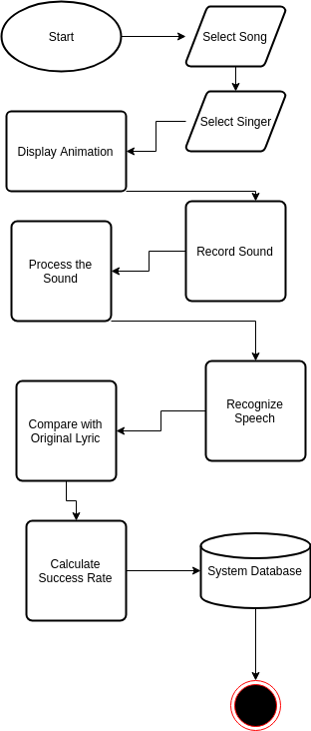
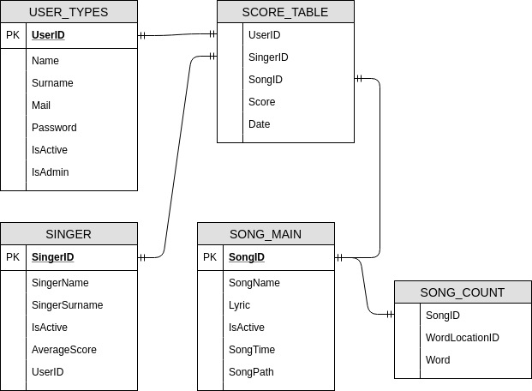
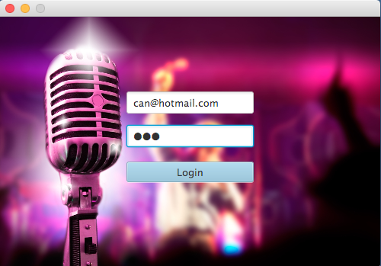
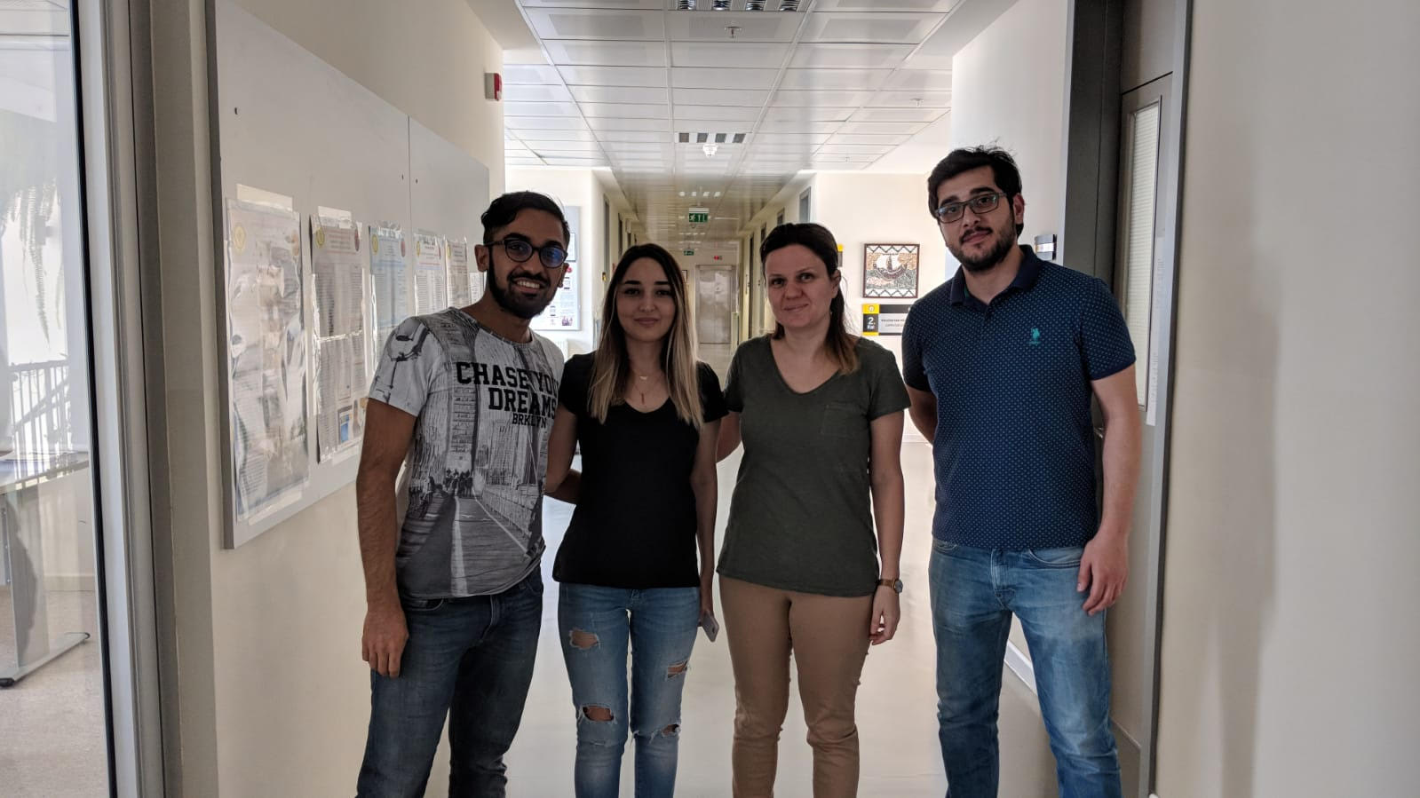
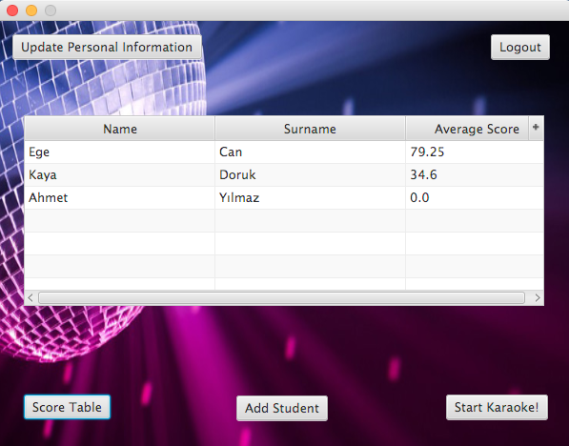
DEVELOPMENT OF A KARAOKE APPLICATION FOR
LANGUAGE LEARNING
Mehmet Ali BEKERECİ – Ege Naz ALARSLAN – Tolga KARAMAN
Assist. Prof. Dr. A. Nurdan Saran
Çankaya University, Department of Computer Engineering
Abstract
Karaoke is an application that is used for entertainment. In karaoke, although scoring seems based on the rate of the singing song correctly, in most of the applications scoring is calculated according to whether the sound signals such as peaks and pit areas in the spectrum, match or not in the coding part. In this project, Karaoke is an application that based on the correct pronunciation of the words during singing and score is designated according to these words, different from other karaoke applications. The aim of this karaoke application is teaching English to the children who are pre-kindergarten level or elementary school level.
Keywords: Karaoke, Speech Recognition, Correct Pronunciation
Introduction
Pronunciation of same word or sentence that is saying by two people, will not give same phonetic identity. Also, there are some issues for speech recognition such as microphone, environment, noise etc. Although these issues shows that difficulty of speech recognition, we have used CMU Sphinx API to minimize these issues in our karaoke application.
In order to calculate the score for each song, we have compared that original lyric text and words that is created from recorded sound. This comparison gives us a fairly high accuracy rate because the accuracy of the sound data obtained using the Sphinx library is high.
Figure 2 – Activity Diagram
Results & Conclusion
In conclusion, we have created karaoke application that is based on the natural language learning process in order to teach language to children who are kindergarten level and elementary school level. For developing this project, we have done an in-depth investigation of related works, usable tools, available source and programming language. We have analyzed the karaoke applications used nowadays and methods of the speech recognizing needed to control the correct pronunciation. As a consequence of these study, we have learned new concepts about computer science such as Sphinx libraries, Java programming language, and their integration.
Solution
This application consists of three main parts which are displaying lyrics on the screen, recording singer's voice and operate with that sound, displaying the score table. In the part of displaying lyrics to the screen in the application, the user will select singer from singer list and choose a song from the playlist that they've chosen and managed. After that, demand will open karaoke panel for the singer to see the lyrics of the song. In the recording singer's voice and operate with that sound part of the application, the singer will sing the song that she/he had chosen earlier, by using microphone simultaneously with the screen that shows lyrics of the song and application will record singer's voice and start examining that sound.
After the examination of the sound, the application will calculate the success rate of similarity between original song and singer's voice and send the details of success to the score table. In the part of displaying the score table in the application, the user can see the details of success rate which consist of a percentage of similarity and number of words that match with the original song, which song that user sing, which singer sing a song, and date.
Figure 1 – Database
Acknowledgement
We are grateful to Assist. Prof. Dr. A. Nurdan Saran due to helping us in every step of our project.
Figure 2 – Finished Product

